Slide 1
Spiritual Paths
Through
Difficult Conversations
Aaron Wolf
May 2017

Slide 2
Four Worlds Framework:
Four Needs and Four Claims
Physical | Positions
Emotional | Interests
Perceptual | Values
Spiritual | Harmony
NEEDS FOR:
Intrapersonal
Interpersonal
Groups
Nations
CLAIMS:
Expressions of needs in negotiations

Slide 3
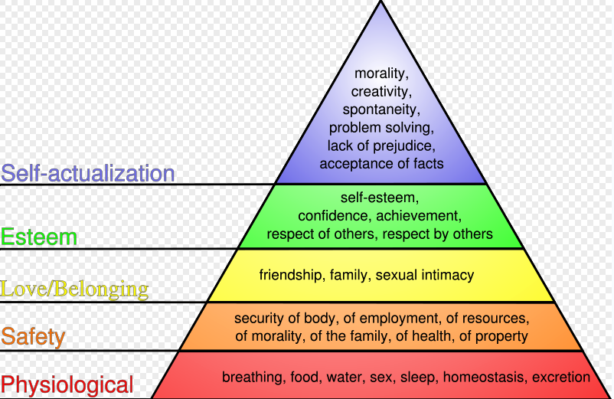

Slide 4
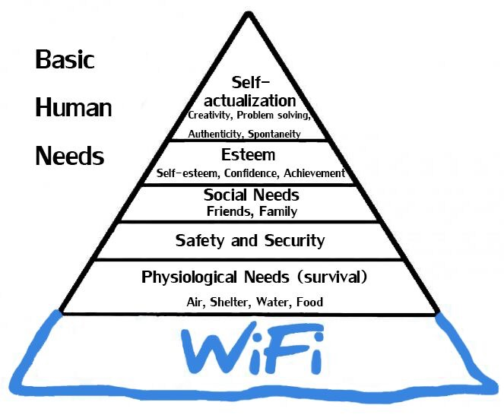

Slide 5
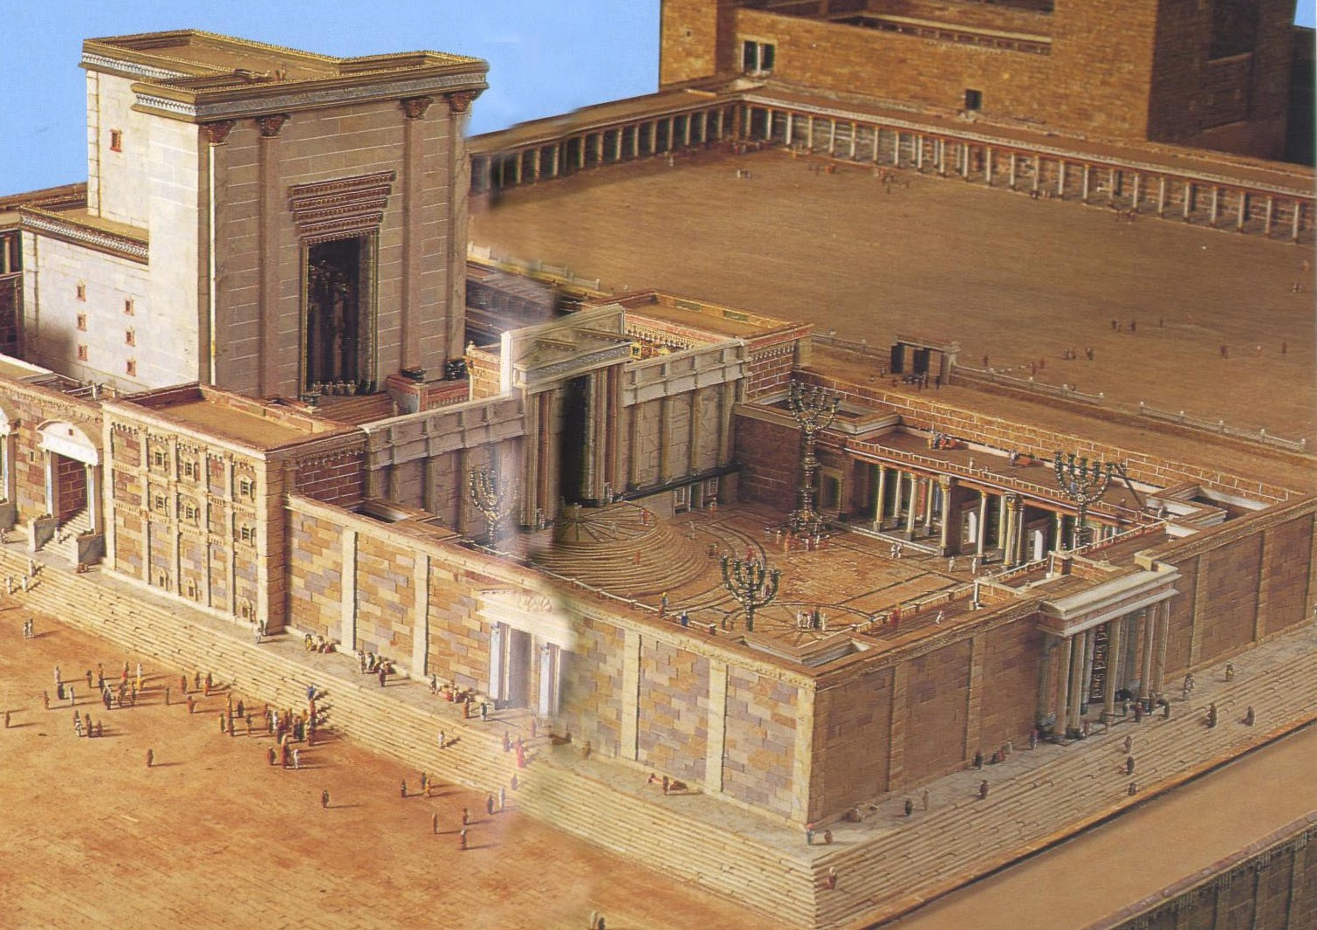

Slide 6
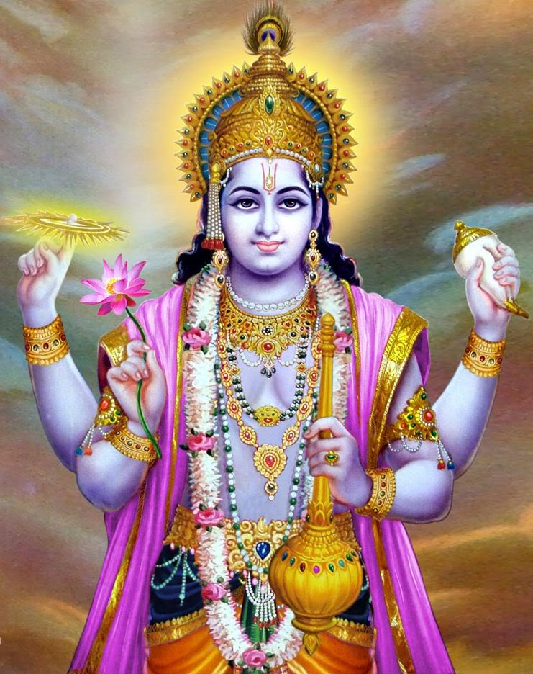
Vishnu’s 4 totems
mace – physical strength
lotus flower – glory of existence
discus – mind chakra
conch – OM: primeval sound
    of all creation

Slide 7

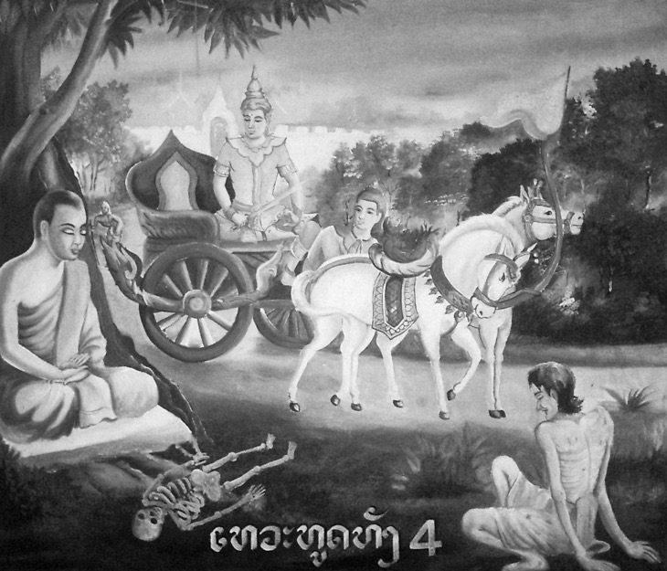

Slide 8
Four Worlds Framework in Islam
Physical | Sharia (law)
Emotional | Tarikah (prayer of the heart)
Perceptual | Hakika (truth)
Spiritual | Marifah (attune-ment)
NEEDS FOR:
Intrapersonal
Interpersonal
Groups
Nations

Slide 9
Men
Father sky
Objective
West
North
East
South
Physical
Mental
Medicine Wheel from Shoshone-Bannock and Oglala Lakota Traditions
Source: Sammy Matsaw Jr. 2016
Spiritual
Emotional
Women
Mother earth
Subjective
Health & Protection
Awareness of problems that are directly related to protection and health of our people and culture.
Traditional Knowledge
Relating Native perspectives to contemporary science, we are striving to achieve better solutions to environmental issues.
Legacies
Renew our legacies by passing on our knowledge and expertise within our families and to our tribal communities.
S.T.E.M.
Learn how to address problems important to Native communities through science, technology, engineering and mathematics.
Health & Protection
Awareness of problems that are directly related to protection and health of our people and culture.
Traditional Knowledge
Relating Native perspectives to contemporary science, we are striving to achieve better solutions to environmental issues.
Legacies
Renew our legacies by passing on our knowledge and expertise within our families and to our tribal communities.
S.T.E.M.
Learn how to address problems important to Native communities through science, technology, engineering and mathematics.

Slide 10
The Kabbalah of Conflict

Slide 11
Active &
Transformative Listening

Slide 12
Listening
Active Listening
  Paying Attention
    Body Language
    Separate out cultural, personal differences
  Eliciting
    Ask. Ask (non-threatening) questions. Useful both to better understand the speaker, and also to reassure them that you are really listening;
  Reflecting
    ▪ Repeat main points. This lets the speaker know that they have really been heard, a powerful psychological message, as well as helping to focus the dialogue;
    "I" not "you" statements.
    ▪ Future, not history.

Slide 13
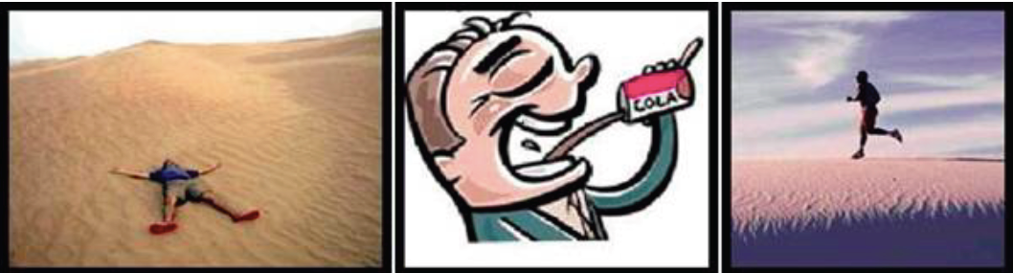

Slide 14
Balance in Conflict
Mercy/Other
Justice/Self
Anger/
The Other Side
Compassion
Universal?

Slide 15
Balance in Conflict
Ar-Rahman/
Son
Al-Hakam/
Father
Mercy/Other
Justice/Self
Anger/
The Other Side
Ar-Rahim/
Holy Spirit
Compassion
Universal?

Slide 16

Yin Yang

Slide 17
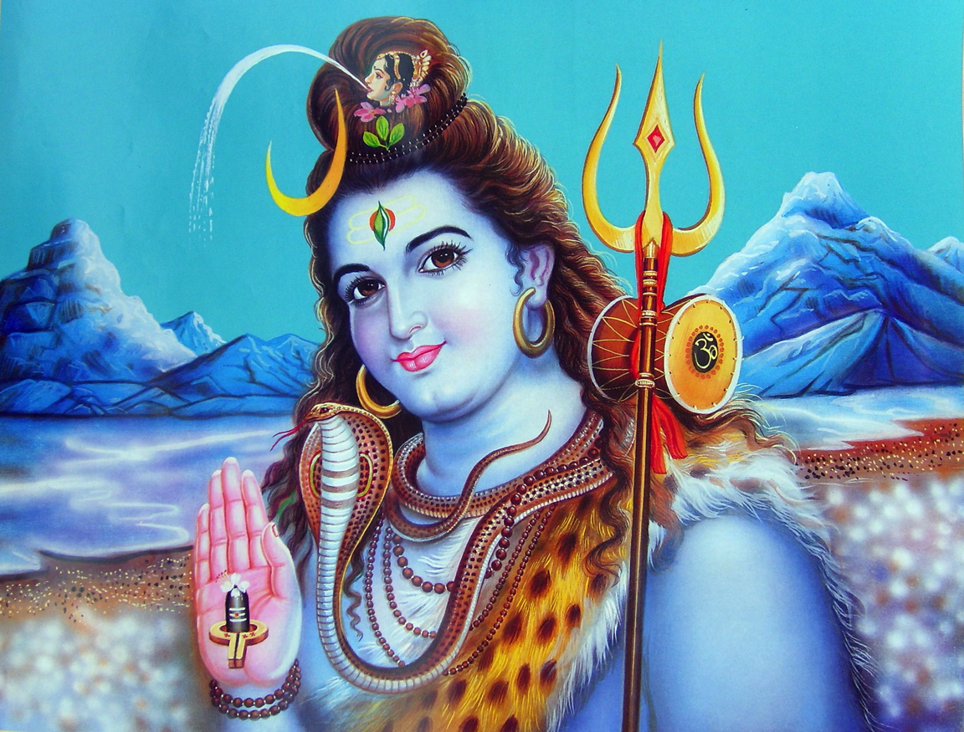



Slide 18
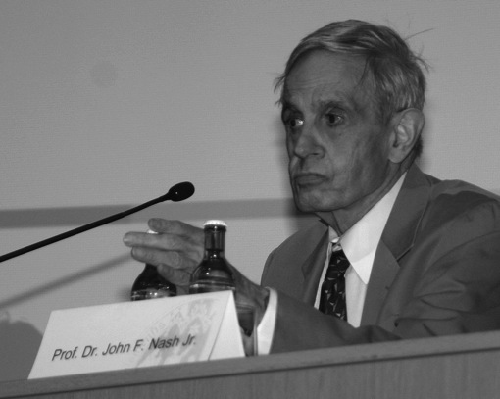
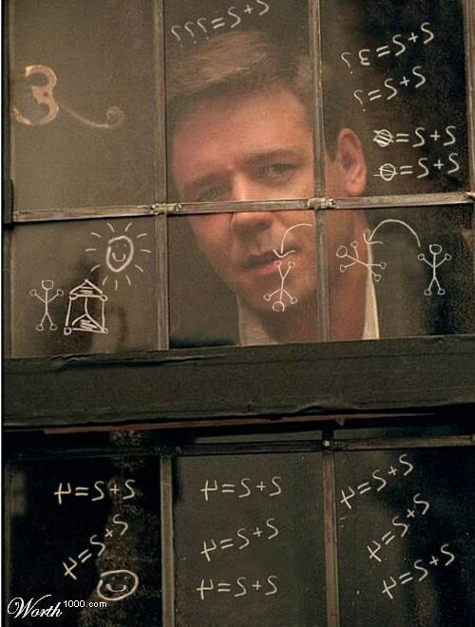
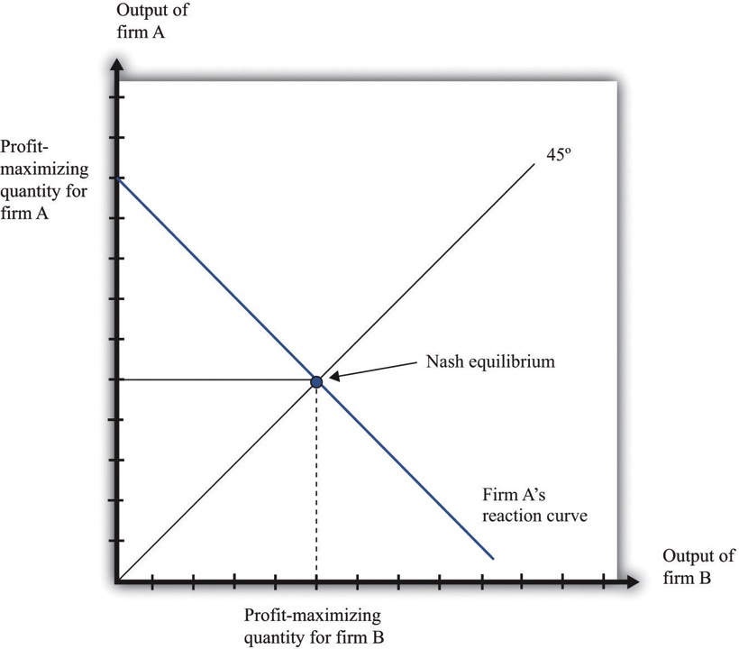

Slide 19
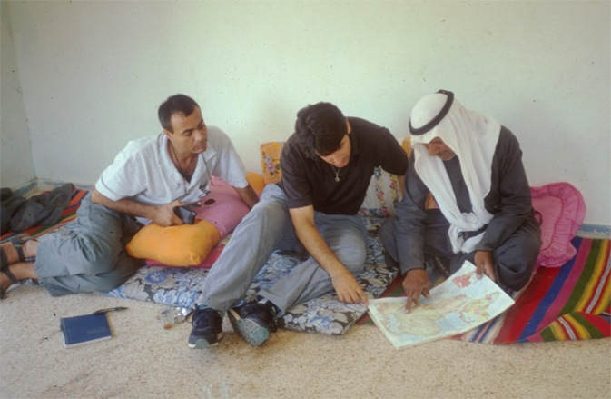
Sulha: Reconciliation
From musalaha, reconciliation: hostilities ended, honor re-established, and peace restored in the community.
Two basic elements: rights and honor.
Tarrahdhin: “Resolution of a conflict that involves no humiliation.”

Slide 20
Listening
Active Listening
  Paying Attention
  Eliciting
  Reflecting
Transformative Listening
  Space
  Tracking
  Offer without insisting
  Check for completeness
Most will listen once listened to
Transformation dissipates anger, allows for empathy
Helps understand interests behind positions (anger masks pain or vulnerability)

Slide 21
Sh’ma!
Silence illuminates our souls,
whispers to our hearts,
and brings them together. —Kahlil Gibran
Silence also teaches us how to speak. . . . Before we speak, whether to share our own experience or to react on another’s, we listen in the silence. From this makom, this grounding in silence, we enter the Makom, the presence of God. This is the stance of Elijah at the cave, finding God in the “still, small voice”—literally, “the thin voice of silence.” From that place of deeper listening, not to each other but to God, the Holy, the deeper inner wisdom of our souls, we find the words that encourage each other to claim the truth and mystery of our lives.
What “trains” us to be spiritual companions for each other? The silence.
-- Anne Kline
“Being listened to is so close to being loved that most people cannot tell the dif- ference.”
—David Augsburger, Mennonite theologian, Fuller Theological Seminary
If you wish to be understood,
seek first to understand.
-- Stephen Covey

Slide 22
Balance in Conflict
Mercy/Other
Justice/Self
Anger/
The Other Side
Listen!
Observe -- detach
from interpretations
Emotion protects
vulnerability (4 worlds)
Listen transformatively
Engage from understanding
Compassion

Slide 23
Forthcoming, Island Press, Fall 2017

