Slide 1

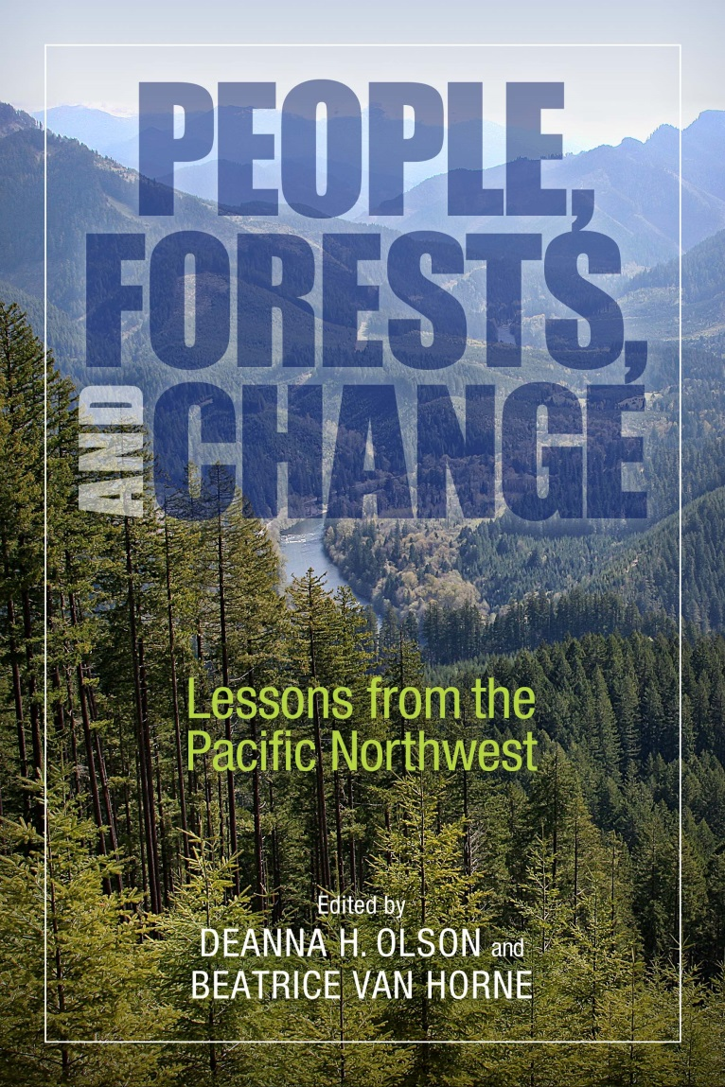
Dynamics of the Human-Forest Ecosystem
Key lessons learned
Future management for sustainable ecosystem services
Notes:
This book is a synopsis of our knowledge of Moist Coniferous Forests in the Northwest, written for an international audience of natural resource managers, students, and the informed public. Editing for voice, tone and content makes for easy reading and concepts that build upon each other, across chapters. We frame the past, characterize today, encapsulate the key new science findings and management lessons learned, and look ahead at what is next.

Slide 2
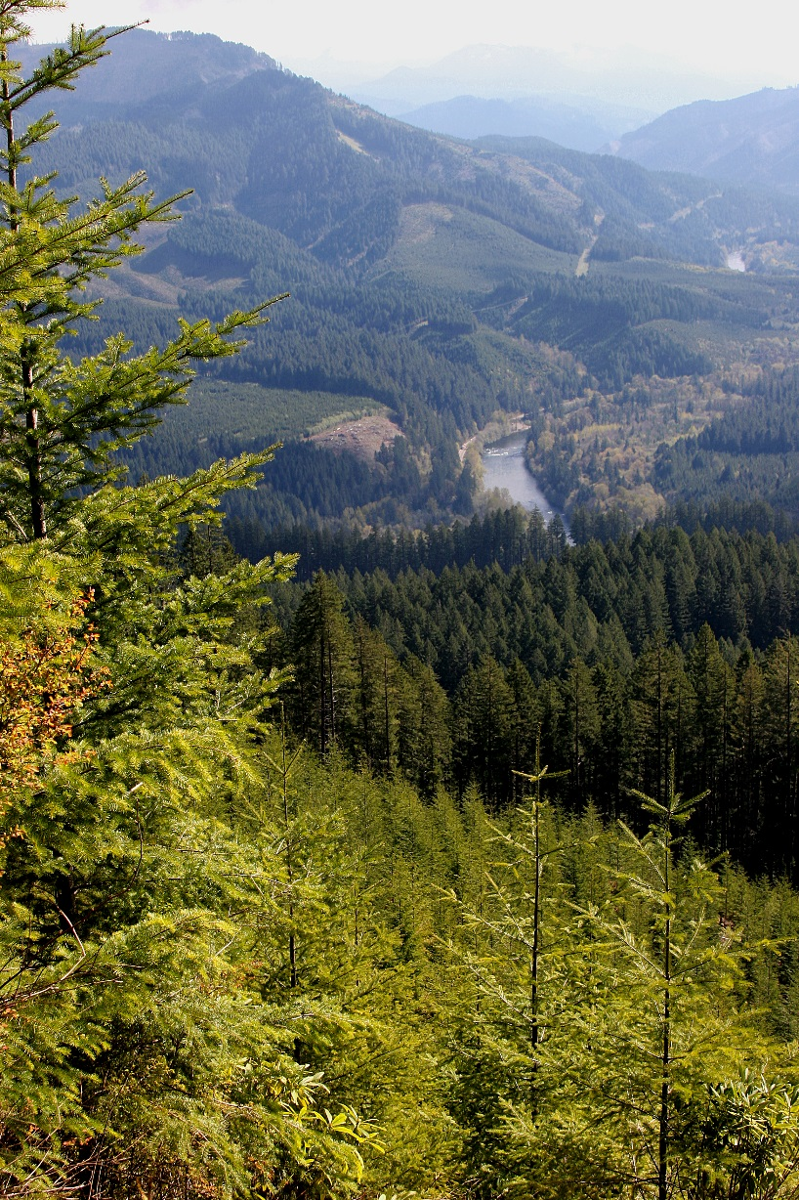
Why did we write this book?
We find ourselves in a pivotal time when reflection and prospective thinking by luminaries and emerging thinkers of our time may lead to substantial advances in forest management and forest sciences, in the Northwest and elsewhere.
Notes:
This book describes the factors that make human-forest ecosystems dynamic and heterogeneous, synthesizes new knowledge from multiple scientific disciplines, and integrates findings to show how management of both natural and human resources could be strengthened.

Slide 3
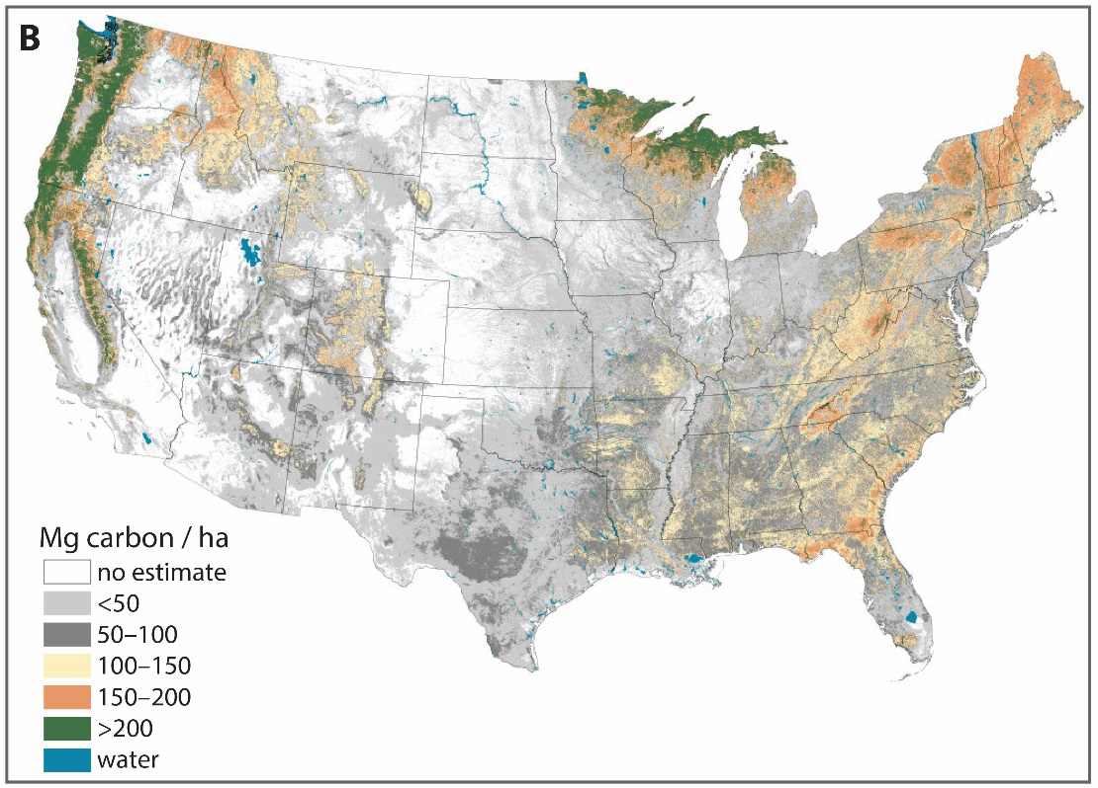
Chapter 1
The Human-Forest Ecosystem
D.H. Olson, B. Van Horne, B. Bormann, P.D. Anderson,
R.W. Haynes
PNW forests sequester CARBON!
Background
Notes:
Creation of today’s human-forest ecosystems has altered forest sustainability objectives from a focus on timber to providing a broader array of ecological services. We are seeing an increase in the amplitude and frequency of change to forests because of human actions, climate change, fire, and other disturbances. This book provides baseline historical context, new knowledge over the last 2–3 decades, and insights into new directions for the next phases of forest management

Slide 4
Chapter 2
Vegetation Ecology and Dynamics
J.F. Franklin, T.A. Spies, F.J. Swanson
Pre-forest (early-seral)
Background
Notes:
Complex vegetation patterns of northwest moist coniferous forests set the stage for a flexible approach to focused commodity production and policies supporting multiple silvicultural methods. Diversity of vegetation and wildlife through time is maintained with a balance of early (pre-forest) conditions and other stages of forest development.

Slide 5
Chapter 3
People and Forest Plants
S. Stevens Hummel, J.E. Smith
Background
Traditional Resource and Environmental Management (TREM) practices
Notes:
Tending forest plants for human uses yields intergenerational knowledge that can help in managing ecosystems for structural, compositional, and functional diversity. Opportunities for collaboration can integrate cultures and perspectives.

Slide 6
Chapter 4
Wood-Products Markets, Communities and Regional Economies
R.W. Haynes, C.A. Montgomery,
S.J. Alexander
Background
Notes:
The social and economic conditions of forest-based human communities have not been stable over the past century. Dealing with relentless change is a challenge for community residents and those who value working forested landscapes.

Slide 7
Chapter 5
An Ecosystem Service Framework
D.J. Blahna, S.T. Asah, R.L. Deal
fish
biodiversity
wood products
recreation
water
intangibles
Background
Notes:
Valuation systems are being developed to describe forest ecosystem services. But societal agreement is needed on priority services, so that these can be used to evaluate human benefit trade-offs and to design management for key forest resources and their supporting components.
This primer on Ecosystem Services provides an update of valuation systems under development now.

Slide 8
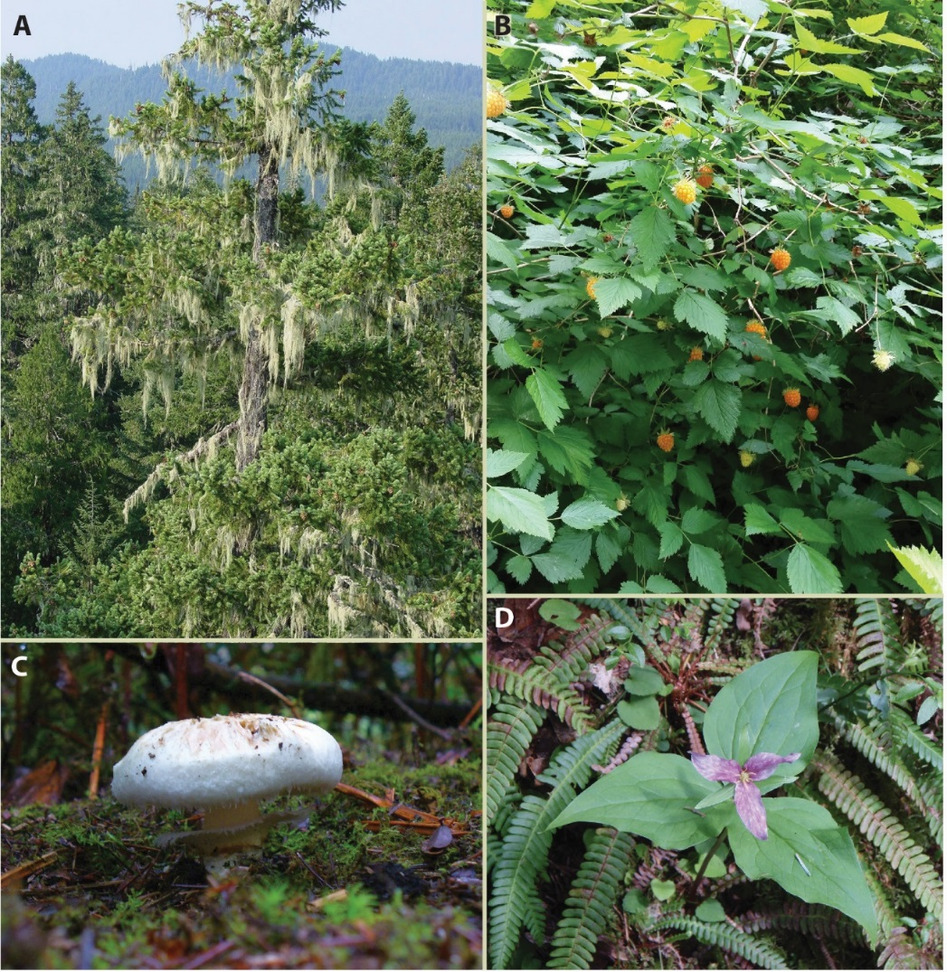
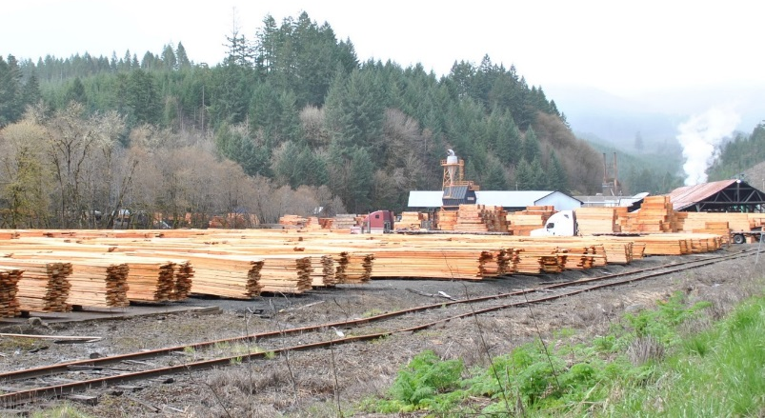
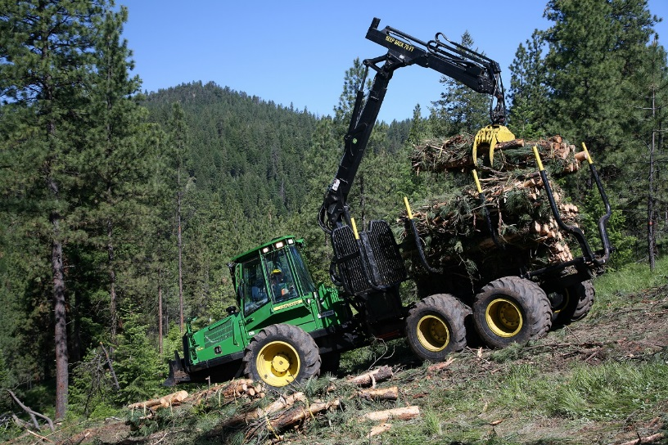
Chapter 6
Ecosystem Services with Diverse Forest Landowners
R.L. Deal, P.E. Hennon, D.V. D’Amore, R.J. Davis, J.E. Smith, E.C. Lowell
Dynamics
Notes:
Historical forest management in the Pacific Northwest has led to a bimodal landscape with local priorities that depend upon landownership. An ecosystem services framework can be used to describe forest benefits for people and to evaluate potential trade-offs among services following management actions.

Slide 9
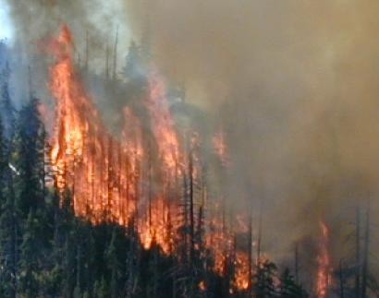
Chapter 7
Patterns of Change across the Forested Landscape
R.J. Davis, A.N. Gray, J.B. Kim, W.B. Cohen
Dynamics
“older forests of today currently cover about half the area they did a century ago”
Notes:
Effects of past ownerships and harvest patterns, reserves, and fires are visible on today’s forest landscape. Today’s decisions will be reflected in future patterns. Conditions are sufficiently changed, and will continue to change, so that returning the forests to 19th-century conditions is not feasible.

Slide 10
Chapter 8
Learning to Learn: the Best Available Science of Adaptive Management
B.T. Bormann, B.K. Williams, T. Minkova
Dynamics
Notes:
Adaptive management requires a disciplined approach to testing, monitoring, and evaluating our ability to reach agreed-upon goals for forest management. While some elements of adaptive management are evident in forest management practices over the last 20 years, several planned projects have been stalled by legal challenges.

Slide 11
Chapter 9
The Emergence of Watershed and Forest Collaboratives
R.L. Flitcroft, L.K. Cerveny, B.T. Bormann, J.E. Smith, S.T. Asah, A.P. Fischer
Dynamics
Oregon: 24 known collaboratives
Notes:
Collaborative groups addressing novel community-scale forest governance at larger spatial scales are being convened regionally. Whether they will succeed has yet to be determined.

Slide 12
Chapter 10
Silviculture for Diverse Objectives
P.D. Anderson, K.J. Puettmann
New Science
Multiscale Practices; Variation; Morticulture; Managing Adaptive Capacity
Notes:
Today’s silviculture is applied at multiple scales. Silvicultural practices can support variation in spread and density of tree cover, and affect suitabilitly of forests and streams for wildlife. Understanding tree death and its role (morticulture) is part of the picture, as is managing adaptive capacity of forests for climate change and other threats. A pulse of alternative silvicultural approaches has been tested in the last few decades, with goals to accelerate development of late-successional forest conditions, achieve ecological objectives during active forest management, and manage fire and other risks.
.

Slide 13
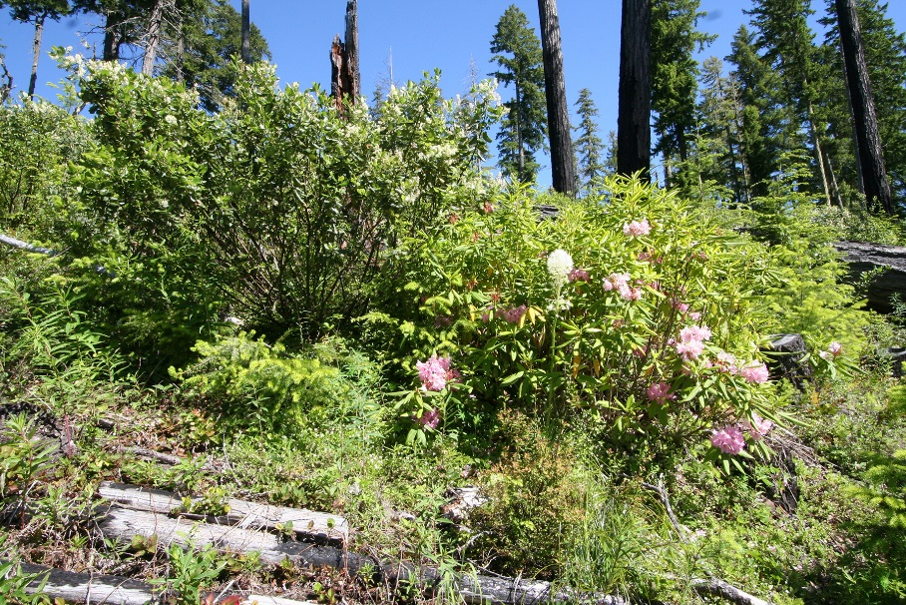
Chapter 11
Long-Term Forest Productivity
B.T. Bormann, S.S. Perakis, R. Darbyshire, J. Hatten
Soils & Nutrients
Biota
Wood & Litter
New Science
Notes:
Productivity of moist coniferous forests is associated with soil diversity, atmospheric conditions (growing seasons, CO2), non-coniferous vegetation, and harvest practices including soil compaction and nutrient retention. Its relationship to fire, downed wood, and active management techniques is more variable.

Slide 14
Chapter 12
Managing Carbon in the Forest Sector
M.E. Harmon, J.L. Campbell
New Science
Notes:
Northwest forests sequester large amounts of carbon, preventing the release of gases that would contribute to the greenhouse effect. Management to retain and restore forest lands, maintain and improve ecosystem and soil productivity, and increase the lifespan of carbon in live and dead wood as well as forest products would maintain or increase the size of this carbon store.

Slide 15
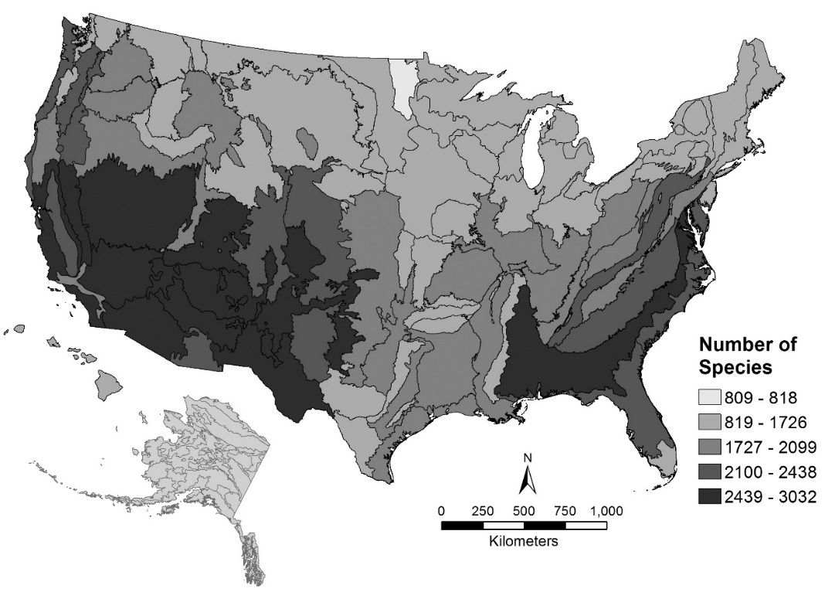
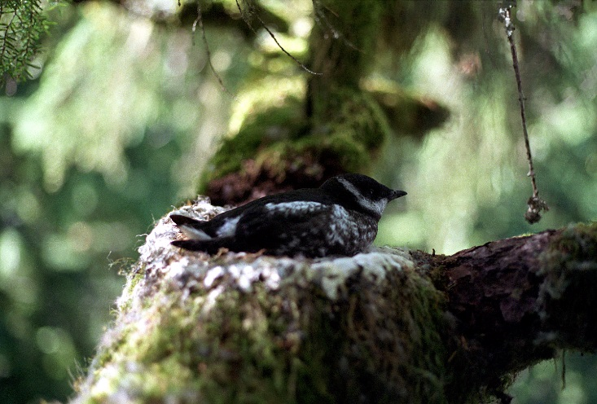
Chapter 13
Biodiversity
D.H. Olson, B.E. Penaluna, B.G. Marcot,
M.G. Raphael, K.B. Aubry
New Science
Taxa like Pacific salmon and marbled murrelets rely on landscapes for persistence
For FS and BLM,
~800 native species of concern in OR & WA
Hamer Environmental
All Species
All Lands
“the main lesson learned about forest biodiversity ... is that all species, all lands, and all stressors matter, forming a complex multistate system”
All Disturbances
Land management is one of many threats to forest species
Notes:
Biodiversity elements as ecosystem services of moist coniferous forests have become a dominant management priority over the last 20 years. Hundreds of species, their life-history variation, and their key ecological functions are being actively managed for long-term persistence. Important lessons include the need to consider multiple disturbances to species, not just effects of timber harvest, and connectivity of their habitat across all land ownerships.

Slide 16
Chapter 14
Aquatic-Riparian Systems
D.H. Olson, S.L. Johnson, P.D. Anderson, B.E. Penaluna, J.B. Dunham
New Science
  Context Matters
Multistate aquatic-riparian conditions require context-dependent management integrating:
Spatial and temporal scales
Critical habitats for species of concern
Key habitat attributes
Multiple disturbances
ecological resilience
Notes:
Aquatic-riparian systems are multi-state, with considerable spatial and temporal variation across the region. Use of stream buffers to forestall adverse effects of timber harvest on critical habitat attributes (temperature, downed wood, landslides) and sensitive species is being tested. Mixed-width riparian buffers are being developed to protect and restore riparian zones for multiple upland and aquatic objectives.

Slide 17
Chapter 15
Watersheds and Landscapes
G.H. Reeves, T.E. Spies
New Science
Concentrate management (and reserves) at watershed scales
Reserves will vary in condition with time since disturbance, and adaptive management to retain suite of conditions will be necessary
Landscape analyses can tailor management to dynamic processes within watersheds (e.g., wood delivery, debris flows, thermal loading)
Notes:
With multiple ecosystem components being aggregated at the larger spatial scales of watersheds and landscapes, management of key structures, functions, and processes for ecological resilience is a priority. Technological and modeling advances in landscape ecology have stimulated active development of tools to bridge science advances and management needs.
This chapter synthesizes key findings from large-scale studies and models.

Slide 18
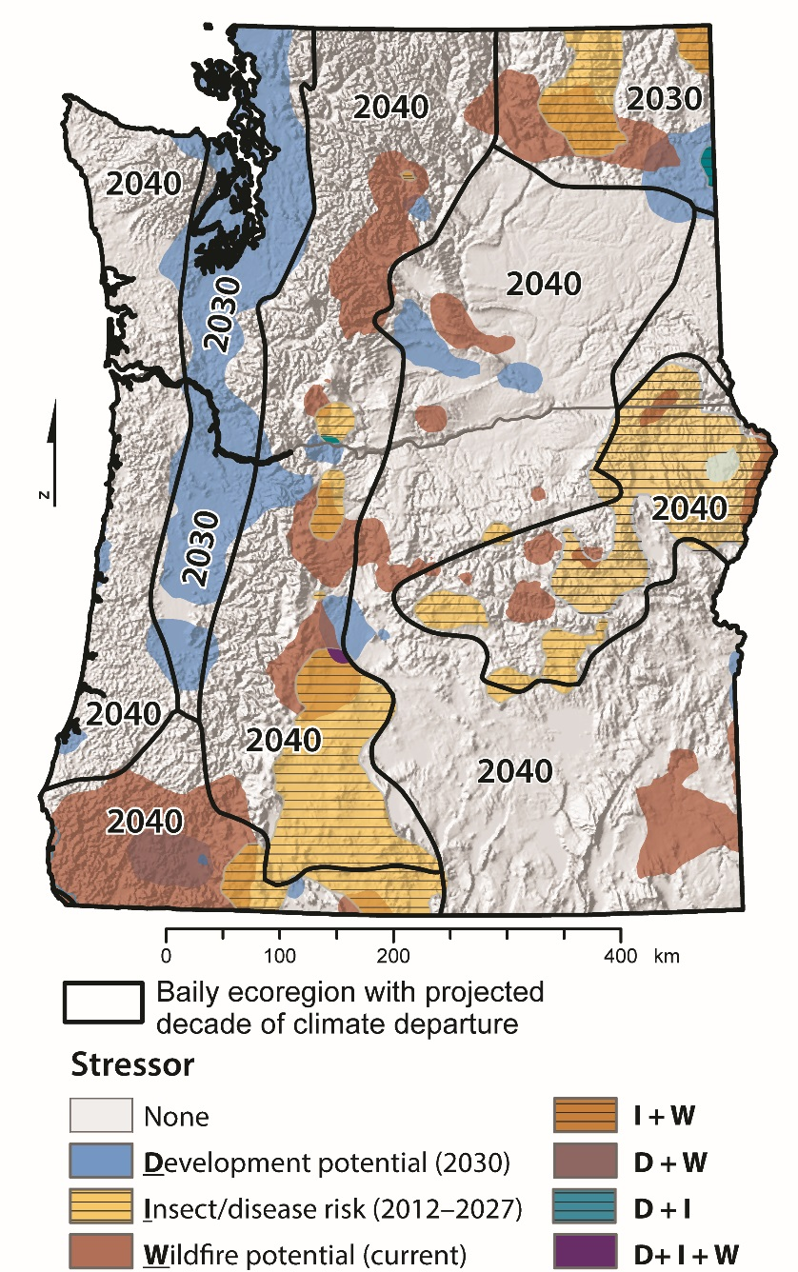
Chapter 16
Climate-Smart Approaches to Managing Forests
J.B. Kim, B.G. Marcot,
D.H. Olson, B. Van Horne,
J.A. Vano, M.S. Hand,
L.A. Salas, M. J. Case,
P.E. Hennon, D.V. D’Amore
Future
Notes:
Climate change patterns in northwest forests are being documented, spurring model development, projections for key ecosystem services, and new management considerations. Climate-smart forest management includes managing for shade, fire risk, and restoration of vegetation for altered climate conditions.

Slide 19
Chapter 17
Next-Generation Products and Greenhouse Gas Implications
E.C. Lowell, V. Yadama, L.R. Schimleck, K.E. Skog
Future
Notes:
A wealth of new forest products relies on component parts of trees for use in construction, chemical engineering, and consumer goods. This is changing and diversifying ways people think about and conduct timber harvesting. Forest products can drive forestry activities and resulting forest conditions.

Slide 20
Chapter 18
Enhancing Public Trust in
Federal Forest Management
M.P. Nelson, H. Gosnell, D.R. Warren, C. Batavia, M. Betts, J.I. Burton, E.J. Davis, M. Schulze, C. Segura,
C.A. Friesen, S.S. Perakis
Future
Notes:
Trust is essential to effective collaboration among stakeholders with an interest in management of moist forests. Distinguishing four types of trust helps in understanding barriers to conflict resolution. Trust can be built with collaborative adaptive management projects, where partners learn together how systems respond to management treatments.

Slide 21
Chapter 19
The Future of Human-Forest Ecosystem Sustainability
D.H. Olson, B. Van Horne, B.T. Bormann, R.L. Deal, T.H. DeLuca
Future
The status quo is not sustainable for forests or human communities
Disturbance dynamics do not respect boundaries; goals encompass entire landscapes
Sustainability goals require implementation across all lands, scales, disciplines
Notes:
This chapter summarizes key findings of Chapters 1-18. Map shows boundaries used in forest planning – useful for different purposes, but some contribute to long-term signatures becoming evident in forest patterns (chapters 6 and 7), which are having consequences for socioeconomic and ecological sustainability and resilience.

Slide 22
Chapter 20
Visions: 20 Years Hence
B. Van Horne, D.H. Olson, T. Maness
Uncertainties
Status Quo
Collaborative Management
Bifurcated landscape
Knitted landscape
Disconnected patches
with differing ES goals
Incentives
Shared ES goals
Boom-bust harvests
New harvest strategies
Resources at risk
Uncertainties
Resources conserved
Socioeconomic gains
Socioeconomic costs
Volatile markets
Fragile collaboratives
Lawsuits
New policies?
Notes:
Two future trajectories are imagined and consequences listed: status quo vs. collaborative management. The status quo trajectory has risks to resources and socioeconomics. Gains can be envisioned by all-lands approaches with collaborative management, yet uncertainties temper those potential successes.
The basic elements of the alternative trajectory are discussed in different words in the GTR.

Slide 23

Thanks to all our contributors
Rural communities
Human well-being
Adaptive management
Collaboratives
TREM practices
Human-Forest Ecosystem
Innovative wood products
Climate adaptation
Trust
Biodiversity
Landscapes
Silviculture
Thanks to funding provided by PNW

